Slide 1
Bassett’s Ministry in France 1993-2019

Slide 2
French Language School Albertville France

Slide 3
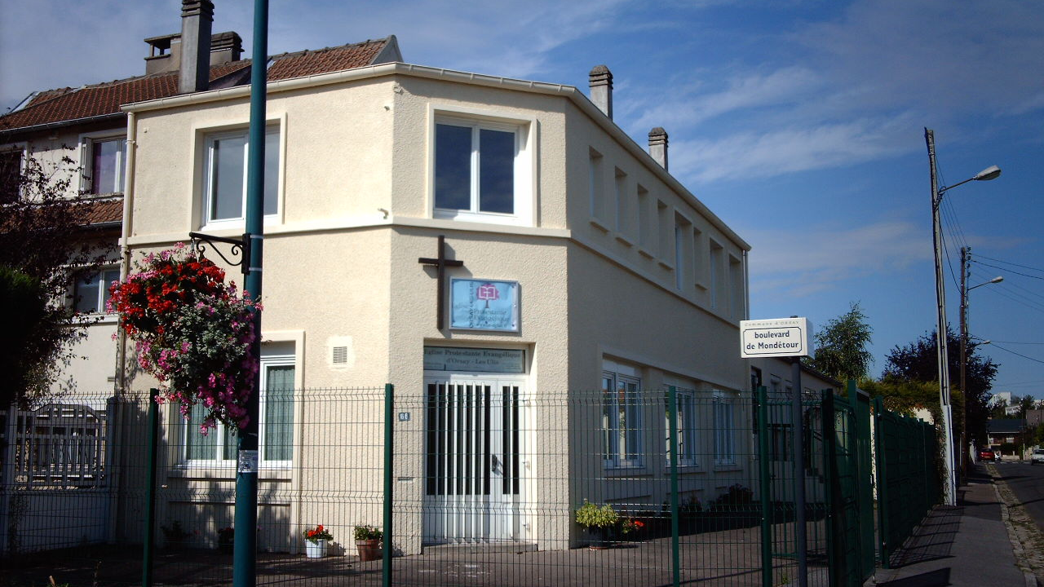
Evangelical Church of Orsay / Les Ulis

Slide 4
Orsay Church 1998 with Alberto

Slide 5
Nadége

Slide 6
Annemie 1958-2014

Slide 7
Meeting in local Hotel 1999-2019

Slide 8
Senlis church 2019

Slide 9
Inauguration of church building October 2001

Slide 10
Eglise Evangélique Protestante de Mennecy 2001-2014

Slide 11
Nicolas’ Ministry at Café des Artistes

Slide 12
Children 2002

Slide 13
Youth 2014

Slide 14
Installation of French Pasteur 2015

Slide 15
Savigny Le Temple Sept.-Dec. 2014

Slide 17
Montargis 2015

Slide 18
Montargis 2019

Slide 19
Montargis Church Retreat 2018

Slide 20
La Mission TEAM France

Slide 21
National Council of French Evangelical Churches

